Slide 1
AI for Medicine
Lecture 16:
Ranked Retrieval– Part II
March 24, 2021
Mohammad Hammoud
Carnegie Mellon University in Qatar

Slide 2
Today…
Last Wednesday’s Session:
  Ranked Retrieval - Part I
Today’s Session:
  Ranked Retrieval – Part II
Announcement:
  Midterm grades are out

Slide 3
The Vector Space Model
We can view terms as axes in a vector space
 | Note 1 | Note 2 | Note 3 | Note 4 | Note 5 | Note 6
Thirst | 4 | 0 | 0 | 3 | 0 | 0
Fatigue | 1 | 0 | 0 | 1 | 0 | 0
Dizziness | 2 | 0 | 0 | 0 | 4 | 0
Fever | 0 | 0 | 0 | 0 | 0 | 0
Cough | 0 | 5 | 0 | 0 | 0 | 5
Headache | 0 | 2 | 3 | 0 | 0 | 0
An axis

Slide 4
The Vector Space Model
We can view terms as axes in a vector space
Cough

Slide 5
The Vector Space Model
We can view terms as axes in a vector space
 | Note 1 | Note 2 | Note 3 | Note 4 | Note 5 | Note 6
Thirst | 4 | 0 | 0 | 3 | 0 | 0
Fatigue | 1 | 0 | 0 | 1 | 0 | 0
Dizziness | 2 | 0 | 0 | 0 | 4 | 0
Fever | 0 | 0 | 0 | 0 | 0 | 0
Cough | 0 | 5 | 0 | 0 | 0 | 5
Headache | 0 | 2 | 3 | 0 | 0 | 0
An axis

Slide 6
The Vector Space Model
We can view terms as axes in a vector space
Cough
Headache

Slide 7
The Vector Space Model
We can also view documents (e.g., medical notes) as vectors in the same vector space
 | Note 1 | Note 2 | Note 3 | Note 4 | Note 5 | Note 6
Thirst | 4 | 0 | 0 | 3 | 0 | 0
Fatigue | 1 | 0 | 0 | 1 | 0 | 0
Dizziness | 2 | 0 | 0 | 0 | 4 | 0
Fever | 0 | 0 | 0 | 0 | 0 | 0
Cough | 0 | 5 | 0 | 0 | 0 | 5
Headache | 0 | 2 | 3 | 0 | 0 | 0
Vector

Slide 8
The Vector Space Model
We can also view documents (e.g., medical notes) as vectors in the same vector space
Cough
Note 3
Headache

Slide 9
The Vector Space Model
We can also view documents (e.g., medical notes) as vectors in the same vector space
 | Note 1 | Note 2 | Note 3 | Note 4 | Note 5 | Note 6
Thirst | 4 | 0 | 0 | 3 | 0 | 0
Fatigue | 1 | 0 | 0 | 1 | 0 | 0
Dizziness | 2 | 0 | 0 | 0 | 4 | 0
Fever | 0 | 0 | 0 | 0 | 0 | 0
Cough | 0 | 5 | 0 | 0 | 0 | 5
Headache | 0 | 2 | 3 | 0 | 0 | 0
Vector

Slide 10
The Vector Space Model
We can also view documents (e.g., medical notes) as vectors in the same vector space
Cough
Note 6
Note 3
Headache

Slide 11
The Vector Space Model
We can also view documents (e.g., medical notes) as vectors in the same vector space
 | Note 1 | Note 2 | Note 3 | Note 4 | Note 5 | Note 6
Thirst | 4 | 0 | 0 | 3 | 0 | 0
Fatigue | 1 | 0 | 0 | 1 | 0 | 0
Dizziness | 2 | 0 | 0 | 0 | 4 | 0
Fever | 0 | 0 | 0 | 0 | 0 | 0
Cough | 0 | 5 | 0 | 0 | 0 | 5
Headache | 0 | 2 | 3 | 0 | 0 | 0
Vector

Slide 12
The Vector Space Model
We can also view documents (e.g., medical notes) as vectors in the same vector space
Note 2
Cough
Note 6
Note 3
Headache

Slide 13
The Vector Space Model
Lastly, we can further view queries as vectors in the same vector space
 | Note 1 | Note 2 | Note 3 | Note 4 | Note 5 | Note 6 | Query
Thirst | 4 | 0 | 0 | 3 | 0 | 0 | 0
Fatigue | 1 | 0 | 0 | 1 | 0 | 0 | 0
Dizziness | 2 | 0 | 0 | 0 | 4 | 0 | 0
Fever | 0 | 0 | 0 | 0 | 0 | 0 | 0
Cough | 0 | 5 | 0 | 0 | 0 | 5 | 5
Headache | 0 | 2 | 3 | 0 | 0 | 0 | 1
Vector

Slide 14
The Vector Space Model
Lastly, we can further view queries as vectors in the same vector space
Note 2
Cough
Note 6
Query
Note 3
Headache

Slide 15
The Vector Space Model
Subsequently, we can rank documents based on their proximity to the query in the vector space
  Proximity is the inverse of distance
As a result, documents that are more relevant to the query will be ranked higher than the documents that are less relevant to the query
Clearly, this contrasts with the Boolean model where documents are either in or out!

Slide 16
Ranking Based on Distance
Let us rank the documents (i.e., notes) based on the Euclidean distance (denoted as Ed) from the query
Note 2
Cough
Note 6
Ed(Query, Note 2)
Ed(Query, Note 2) > Ed(Query, Note 3)
although Query is more similar
to Note 2 than to Note 3!
Query
Ed(Query, Note 3)
Note 3
Headache

Slide 17
Ranking Based on Distance
Let us rank the documents (i.e., notes) based on the Euclidean distance (denoted as Ed) from the query
Note 2
Cough
Note 6
Ed(Query, Note 2)
Ed(Query, Note 6)
Ed(Query, Note 2) > Ed(Query, Note 6)
although Query is more similar
to Note 2 than to Note 6!
Query
Ranking based on Euclidean distance is not effective!
Note 3
Headache

Slide 18
If Not Distance then What?
Let us take a document, d, and append it to itself
  Call the resultant document, d’
“Semantically” d and d’ have the same content although the distance between them could be very large!
Note, however, that the angle between d and d’ in the vector space is 0, corresponding to maximal similarity
Idea: Rank documents based on angles rather than distances!

Slide 19
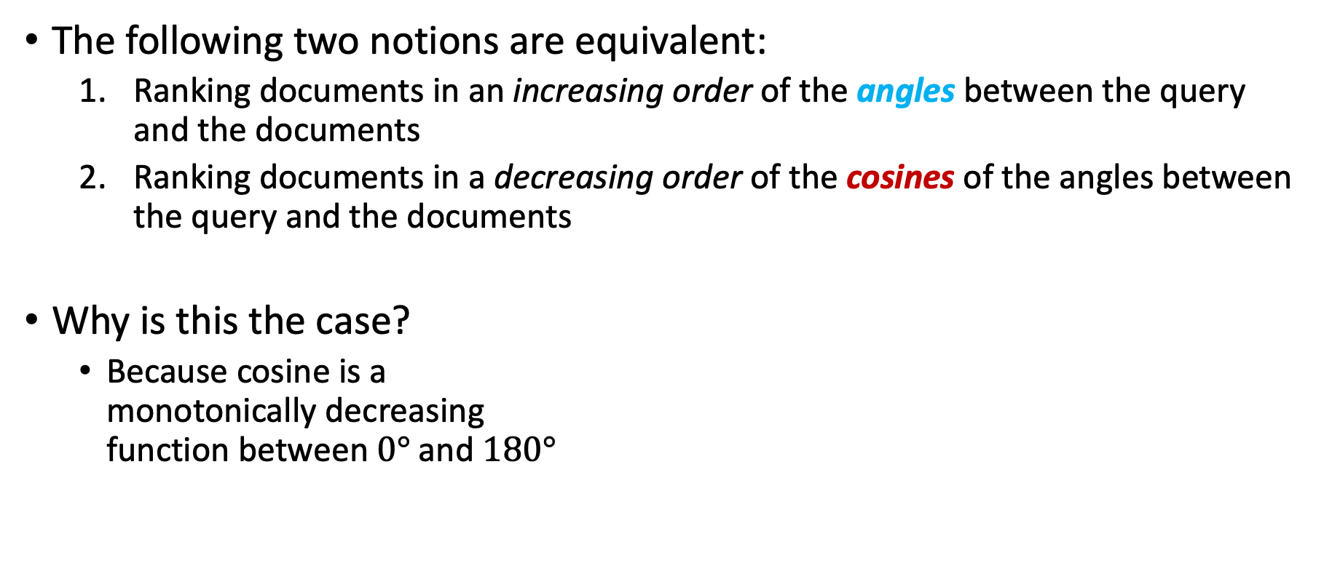



Angle vs. Cosine
The following two notions are equivalent:
  Ranking documents in an increasing order of the angles between the query and the documents
  Ranking documents in a decreasing order of the cosines of the angles between the query and the documents
Why is this the case?
  Because cosine is a
  monotonically decreasing
  function between $0°$and $180°$
Cosine = 1
Cosine
Cosine = 0
Angle
$$0°$$
$$90°$$
$$180°$$
Cosine = -1

Slide 20

Angle vs. Cosine
The following two notions are equivalent:
  Ranking documents in an increasing order of the angles between the query and the documents
  Ranking documents in a decreasing order of the cosines of the angles between the query and the documents
Why is this the case?
  Because cosine is a
  monotonically decreasing
  function between $0°$and $180°$
Cosine = 1
Cosine
Cosine
decreases
As the angle increases till $180°$
Cosine = 0
Angle
$$0°$$
$$90°$$
$$180°$$
Cosine = -1

Slide 21
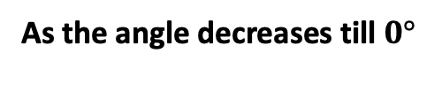
Angle vs. Cosine
The following two notions are equivalent:
  Ranking documents in an increasing order of the angles between the query and the documents
  Ranking documents in a decreasing order of the cosines of the angles between the query and the documents
Why is this the case?
  Because cosine is a
  monotonically decreasing
  function between $0°$and $180°$
Cosine = 1
Cosine
Cosine
increases
As the angle decreases till $0°$
Cosine = 0
Angle
$$0°$$
$$90°$$
$$180°$$
Cosine = -1

Slide 22

Angle vs. Cosine
The following two notions are equivalent:
  Ranking documents in an increasing order of the angles between the query and the documents
  Ranking documents in a decreasing order of the cosines of the angles between the query and the documents
Why is this the case?
  Because cosine is a
  monotonically decreasing
  function between $0°$and $180°$
The larger the cosine, the smaller the angle in the interval
[$0°$, $180°$]

Slide 23
Angle vs. Cosine
The following two notions are equivalent:
  Ranking documents in an increasing order of the angles between the query and the documents
  Ranking documents in a decreasing order of the cosines of the angles between the query and the documents
Why is this the case?
  Because cosine is a
  monotonically decreasing
  function between $0°$and $180°$
But, why should we use cosines instead of angles?

Slide 24
Angle vs. Cosine
The following two notions are equivalent:
  Ranking documents in an increasing order of the angles between the query and the documents
  Ranking documents in a decreasing order of the cosines of the angles between the query and the documents
Why is this the case?
  Because cosine is a
  monotonically decreasing
  function between $0°$and $180°$
There is a very efficient way of computing cosines using vector arithmetic

Slide 25
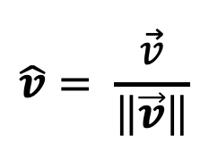
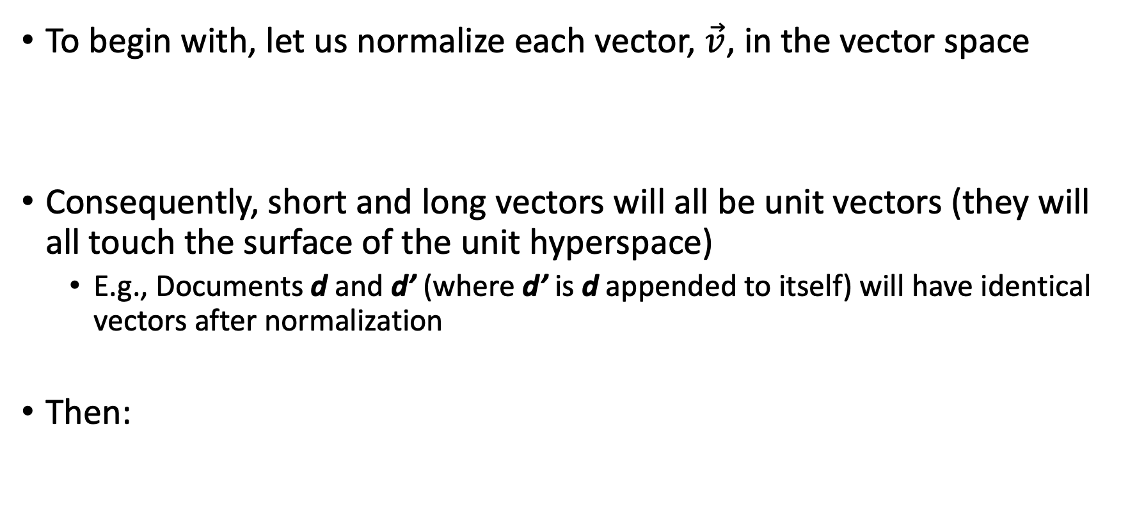

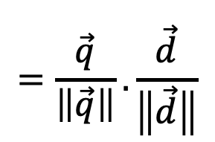
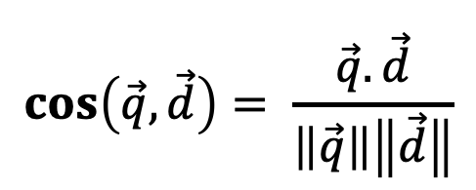
Cosine Similarity
To begin with, let us normalize each vector, $\vec{v}$, in the vector space
Consequently, short and long vectors will all be unit vectors (they will all touch the surface of the unit hyperspace)
  E.g., Documents d and d’ (where d’ is d appended to itself) will have identical vectors after normalization
Then:
$$\hat{v}= \frac{\vec{v}}{\left\|\vec{v}\right\|}$$
Unit vector
To compute cosine, we
simply multiply two unit
vectors
$$\cos\left(\vec{q},\vec{d}\right)= \frac{\vec{q}.\vec{d}}{\left\|\vec{q}\right\|\left\|\vec{d}\right\|}$$
$$=\frac{\vec{q}}{\left\|\vec{q}\right\|}.\frac{\vec{d}}{\left\|\vec{d}\right\|}$$
$$=\hat{q}.\hat{d}$$
Unit vector

Slide 26
Cosine Similarity Illustrated
Un-normalized Vectors
Normalized Vectors
Note 2
Cough
Cough
Note 6
Note 6
Unit Hyperspace
Query
Query
Note 2
Note 3
Note 3
Headache
Headache

Slide 27





Cosine Similarity And Ranking Illustrated
The smaller the angle,
the larger the cosine:
Cough
Note 6
$$θ_{1}<θ_{0}<θ_{2}$$
Query
Note 2
$${⇒cos(θ}_{1})>{cos(θ}_{0})>{cos(θ}_{2})$$
Rank By Cosine in Decreasing Order
Note 2
Note 6
Note 3
$$θ_{0}$$
$$θ_{1}$$
Note 3
$$θ_{2}$$
Headache

Slide 28
Example
Here is the term-document TF.IDF matrix of our running example, with the query being represented as a vector as well
 | Note 1 | Note 2 | Note 3 | Note 4 | Note 5 | Note 6 | Query
Thirst | 0.76437687 | 0 | 0 | 0.70476595 | 0 | 0 | 0
Fatigue | 0.47712125 | 0 | 0 | 0.47712125 | 0 | 0 | 0
Dizziness | 0.62074906 | 0 | 0 | 0 | 0.76437687 | 0 | 0
Fever | 0 | 0 | 0 | 0 | 0.77815125 | 0 | 0
Cough | 0 | 0.8106147 | 0 | 0 | 0 | 0.8106147 | 0.8106147
Headache | 0 | 0.62074906 | 0.70476595 | 0 | 0 | 0 | 0.47712125

Slide 29
Example
Here is the corresponding term-document normalized TF.IDF matrix
 | Note 1 | Note 2 | Note 3 | Note 4 | Note 5 | Note 6 | Query
Thirst | 0.69857948 | 0 | 0 | 0.82808279 | 0 | 0 | 0
Fatigue | 0.43605076 | 0 | 0 | 0.56060583 | 0 | 0 | 0
Dizziness | 0.56731512 | 0 | 0 | 0 | 0.70076456 | 0 | 0
Fever | 0 | 0 | 0 | 0 | 0.71339262 | 0 | 0
Cough | 0 | 0.79394779 | 0 | 0 | 0 | 1 | 0.86179988
Headache | 0 | 0.60798595 | 1 | 0 | 0 | 0 | 0.50724843
Rank (Score)
Note 1 (0)
$$\operatorname{Cos}\left(Query, Note 1\right)=\left(0.69×0\right)+\left(0.43×0\right)+\left(0.56×0\right)+\left(0×0\right)+\left(0×0.86\right)+\left(0×0.5\right)=0$$

Slide 30
Example
Here is the corresponding term-document normalized TF.IDF matrix
 | Note 1 | Note 2 | Note 3 | Note 4 | Note 5 | Note 6 | Query
Thirst | 0.69857948 | 0 | 0 | 0.82808279 | 0 | 0 | 0
Fatigue | 0.43605076 | 0 | 0 | 0.56060583 | 0 | 0 | 0
Dizziness | 0.56731512 | 0 | 0 | 0 | 0.70076456 | 0 | 0
Fever | 0 | 0 | 0 | 0 | 0.71339262 | 0 | 0
Cough | 0 | 0.79394779 | 0 | 0 | 0 | 1 | 0.86179988
Headache | 0 | 0.60798595 | 1 | 0 | 0 | 0 | 0.50724843
Rank (Score)
Note 1 (0)
$$\operatorname{Cos}\left(Query, Note 2\right)=\left(0×0\right)+\left(0×0\right)+\left(0×0\right)+\left(0×0\right)+\left(0.79×0.86\right)+\left(0.6×0.5\right)=0.99$$

Slide 31
Example
Here is the corresponding term-document normalized TF.IDF matrix
 | Note 1 | Note 2 | Note 3 | Note 4 | Note 5 | Note 6 | Query
Thirst | 0.69857948 | 0 | 0 | 0.82808279 | 0 | 0 | 0
Fatigue | 0.43605076 | 0 | 0 | 0.56060583 | 0 | 0 | 0
Dizziness | 0.56731512 | 0 | 0 | 0 | 0.70076456 | 0 | 0
Fever | 0 | 0 | 0 | 0 | 0.71339262 | 0 | 0
Cough | 0 | 0.79394779 | 0 | 0 | 0 | 1 | 0.86179988
Headache | 0 | 0.60798595 | 1 | 0 | 0 | 0 | 0.50724843
Rank (Score)
Note 2 (0.99)
Note 1 (0)
$$\operatorname{Cos}\left(Query, Note 2\right)=\left(0×0\right)+\left(0×0\right)+\left(0×0\right)+\left(0×0\right)+\left(0.79×0.86\right)+\left(0.6×0.5\right)=0.99$$

Slide 32
Example
Here is the corresponding term-document normalized TF.IDF matrix
 | Note 1 | Note 2 | Note 3 | Note 4 | Note 5 | Note 6 | Query
Thirst | 0.69857948 | 0 | 0 | 0.82808279 | 0 | 0 | 0
Fatigue | 0.43605076 | 0 | 0 | 0.56060583 | 0 | 0 | 0
Dizziness | 0.56731512 | 0 | 0 | 0 | 0.70076456 | 0 | 0
Fever | 0 | 0 | 0 | 0 | 0.71339262 | 0 | 0
Cough | 0 | 0.79394779 | 0 | 0 | 0 | 1 | 0.86179988
Headache | 0 | 0.60798595 | 1 | 0 | 0 | 0 | 0.50724843
Rank (Score)
Note 2 (0.99)
Note 1 (0)
$$\operatorname{Cos}\left(Query, Note 3\right)=\left(0×0\right)+\left(0×0\right)+\left(0×0\right)+\left(0×0\right)+\left(0×0.86\right)+\left(1×0.5\right)=0.5$$

Slide 33
Example
Here is the corresponding term-document normalized TF.IDF matrix
 | Note 1 | Note 2 | Note 3 | Note 4 | Note 5 | Note 6 | Query
Thirst | 0.69857948 | 0 | 0 | 0.82808279 | 0 | 0 | 0
Fatigue | 0.43605076 | 0 | 0 | 0.56060583 | 0 | 0 | 0
Dizziness | 0.56731512 | 0 | 0 | 0 | 0.70076456 | 0 | 0
Fever | 0 | 0 | 0 | 0 | 0.71339262 | 0 | 0
Cough | 0 | 0.79394779 | 0 | 0 | 0 | 1 | 0.86179988
Headache | 0 | 0.60798595 | 1 | 0 | 0 | 0 | 0.50724843
Rank (Score)
Note 2 (0.99)
Note 3 (0.5)
Note 1 (0)
$$\operatorname{Cos}\left(Query, Note 3\right)=\left(0×0\right)+\left(0×0\right)+\left(0×0\right)+\left(0×0\right)+\left(0×0.86\right)+\left(1×0.5\right)=0.5$$

Slide 34
Example
Here is the corresponding term-document normalized TF.IDF matrix
 | Note 1 | Note 2 | Note 3 | Note 4 | Note 5 | Note 6 | Query
Thirst | 0.69857948 | 0 | 0 | 0.82808279 | 0 | 0 | 0
Fatigue | 0.43605076 | 0 | 0 | 0.56060583 | 0 | 0 | 0
Dizziness | 0.56731512 | 0 | 0 | 0 | 0.70076456 | 0 | 0
Fever | 0 | 0 | 0 | 0 | 0.71339262 | 0 | 0
Cough | 0 | 0.79394779 | 0 | 0 | 0 | 1 | 0.86179988
Headache | 0 | 0.60798595 | 1 | 0 | 0 | 0 | 0.50724843
Rank (Score)
Note 2 (0.99)
Note 3 (0.5)
Note 1 (0)
$$\operatorname{Cos}\left(Query, Note 4\right)=\left(0.82×0\right)+\left(0.56×0\right)+\left(0×0\right)+\left(0×0\right)+\left(0×0.86\right)+\left(0×0.5\right)=0$$

Slide 35
Example
Here is the corresponding term-document normalized TF.IDF matrix
 | Note 1 | Note 2 | Note 3 | Note 4 | Note 5 | Note 6 | Query
Thirst | 0.69857948 | 0 | 0 | 0.82808279 | 0 | 0 | 0
Fatigue | 0.43605076 | 0 | 0 | 0.56060583 | 0 | 0 | 0
Dizziness | 0.56731512 | 0 | 0 | 0 | 0.70076456 | 0 | 0
Fever | 0 | 0 | 0 | 0 | 0.71339262 | 0 | 0
Cough | 0 | 0.79394779 | 0 | 0 | 0 | 1 | 0.86179988
Headache | 0 | 0.60798595 | 1 | 0 | 0 | 0 | 0.50724843
Rank (Score)
Note 2 (0.99)
Note 3 (0.5)
Note 1 (0)
Note 4 (0)
$$\operatorname{Cos}\left(Query, Note 4\right)=\left(0.82×0\right)+\left(0.56×0\right)+\left(0×0\right)+\left(0×0\right)+\left(0×0.86\right)+\left(0×0.5\right)=0$$

Slide 36
Example
Here is the corresponding term-document normalized TF.IDF matrix
 | Note 1 | Note 2 | Note 3 | Note 4 | Note 5 | Note 6 | Query
Thirst | 0.69857948 | 0 | 0 | 0.82808279 | 0 | 0 | 0
Fatigue | 0.43605076 | 0 | 0 | 0.56060583 | 0 | 0 | 0
Dizziness | 0.56731512 | 0 | 0 | 0 | 0.70076456 | 0 | 0
Fever | 0 | 0 | 0 | 0 | 0.71339262 | 0 | 0
Cough | 0 | 0.79394779 | 0 | 0 | 0 | 1 | 0.86179988
Headache | 0 | 0.60798595 | 1 | 0 | 0 | 0 | 0.50724843
Rank (Score)
Note 2 (0.99)
Note 3 (0.5)
Note 1 (0)
Note 4 (0)
$$\operatorname{Cos}\left(Query, Note 5\right)=\left(0×0\right)+\left(0×0\right)+\left(0.7×0\right)+\left(0.71×0\right)+\left(0×0.86\right)+\left(0×0.5\right)=0$$

Slide 37
Example
Here is the corresponding term-document normalized TF.IDF matrix
 | Note 1 | Note 2 | Note 3 | Note 4 | Note 5 | Note 6 | Query
Thirst | 0.69857948 | 0 | 0 | 0.82808279 | 0 | 0 | 0
Fatigue | 0.43605076 | 0 | 0 | 0.56060583 | 0 | 0 | 0
Dizziness | 0.56731512 | 0 | 0 | 0 | 0.70076456 | 0 | 0
Fever | 0 | 0 | 0 | 0 | 0.71339262 | 0 | 0
Cough | 0 | 0.79394779 | 0 | 0 | 0 | 1 | 0.86179988
Headache | 0 | 0.60798595 | 1 | 0 | 0 | 0 | 0.50724843
Rank (Score)
Note 2 (0.99)
Note 3 (0.5)
Note 1 (0)
Note 4 (0)
Note 5 (0)
$$\operatorname{Cos}\left(Query, Note 5\right)=\left(0×0\right)+\left(0×0\right)+\left(0.7×0\right)+\left(0.71×0\right)+\left(0×0.86\right)+\left(0×0.5\right)=0$$

Slide 38
Example
Here is the corresponding term-document normalized TF.IDF matrix
 | Note 1 | Note 2 | Note 3 | Note 4 | Note 5 | Note 6 | Query
Thirst | 0.69857948 | 0 | 0 | 0.82808279 | 0 | 0 | 0
Fatigue | 0.43605076 | 0 | 0 | 0.56060583 | 0 | 0 | 0
Dizziness | 0.56731512 | 0 | 0 | 0 | 0.70076456 | 0 | 0
Fever | 0 | 0 | 0 | 0 | 0.71339262 | 0 | 0
Cough | 0 | 0.79394779 | 0 | 0 | 0 | 1 | 0.86179988
Headache | 0 | 0.60798595 | 1 | 0 | 0 | 0 | 0.50724843
Rank (Score)
Note 2 (0.99)
Note 3 (0.5)
Note 1 (0)
Note 4 (0)
Note 5 (0)
$\operatorname{Cos}\left(Query, Note 6\right)=\left(0×0\right)+\left(0×0\right)+\left(0×0\right)+\left(0×0\right)+\left(1×0.86\right)+\left(0×0.5\right)=0$.86

Slide 39
Example
Here is the corresponding term-document normalized TF.IDF matrix
 | Note 1 | Note 2 | Note 3 | Note 4 | Note 5 | Note 6 | Query
Thirst | 0.69857948 | 0 | 0 | 0.82808279 | 0 | 0 | 0
Fatigue | 0.43605076 | 0 | 0 | 0.56060583 | 0 | 0 | 0
Dizziness | 0.56731512 | 0 | 0 | 0 | 0.70076456 | 0 | 0
Fever | 0 | 0 | 0 | 0 | 0.71339262 | 0 | 0
Cough | 0 | 0.79394779 | 0 | 0 | 0 | 1 | 0.86179988
Headache | 0 | 0.60798595 | 1 | 0 | 0 | 0 | 0.50724843
Rank (Score)
Note 2 (0.99)
Note 6 (0.86)
Note 3 (0.5)
Note 1 (0)
Note 4 (0)
Note 5 (0)
$\operatorname{Cos}\left(Query, Note 6\right)=\left(0×0\right)+\left(0×0\right)+\left(0×0\right)+\left(0×0\right)+\left(1×0.86\right)+\left(0×0.5\right)=0$.86

Slide 40
Next Wednesday’s Class…
Recommendation Systems

Slide 41
References
Schütze, Hinrich, Christopher D. Manning, and Prabhakar Raghavan. Introduction to information retrieval. Vol. 39. Cambridge: Cambridge University Press, 2008.

